Slide 1




Introduction to image analysis
With material from
Robert Haase, Physics of Life, TU Dresden
With Fiji (ImageJ and others)
FACSI - Faculty of Agriculture Center for Scientific Imaging
Daniel Waiger, HUJI, FACSI

Slide 2
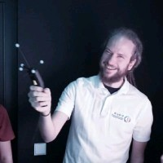
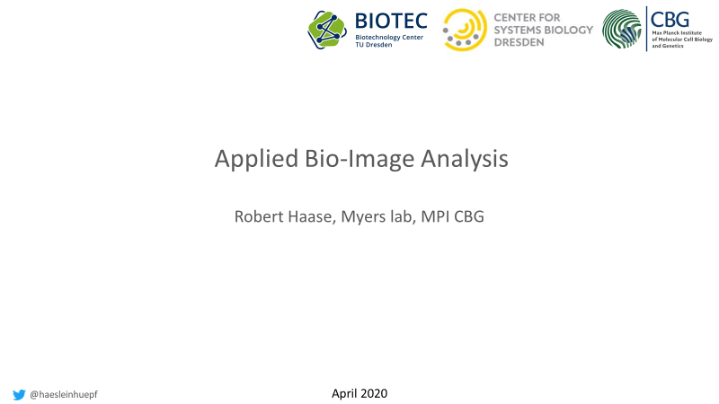

Major credit * 10⁶ to…
Lecture BioImage Analysis 2020
Robert Haase, Physics of Life, TU Dresden
For sharing his slides and for his important contribution to the field of image analysis
https://git.mpi-cbg.de/rhaase/lecture_applied_bioimage_analysis_2020

Slide 3
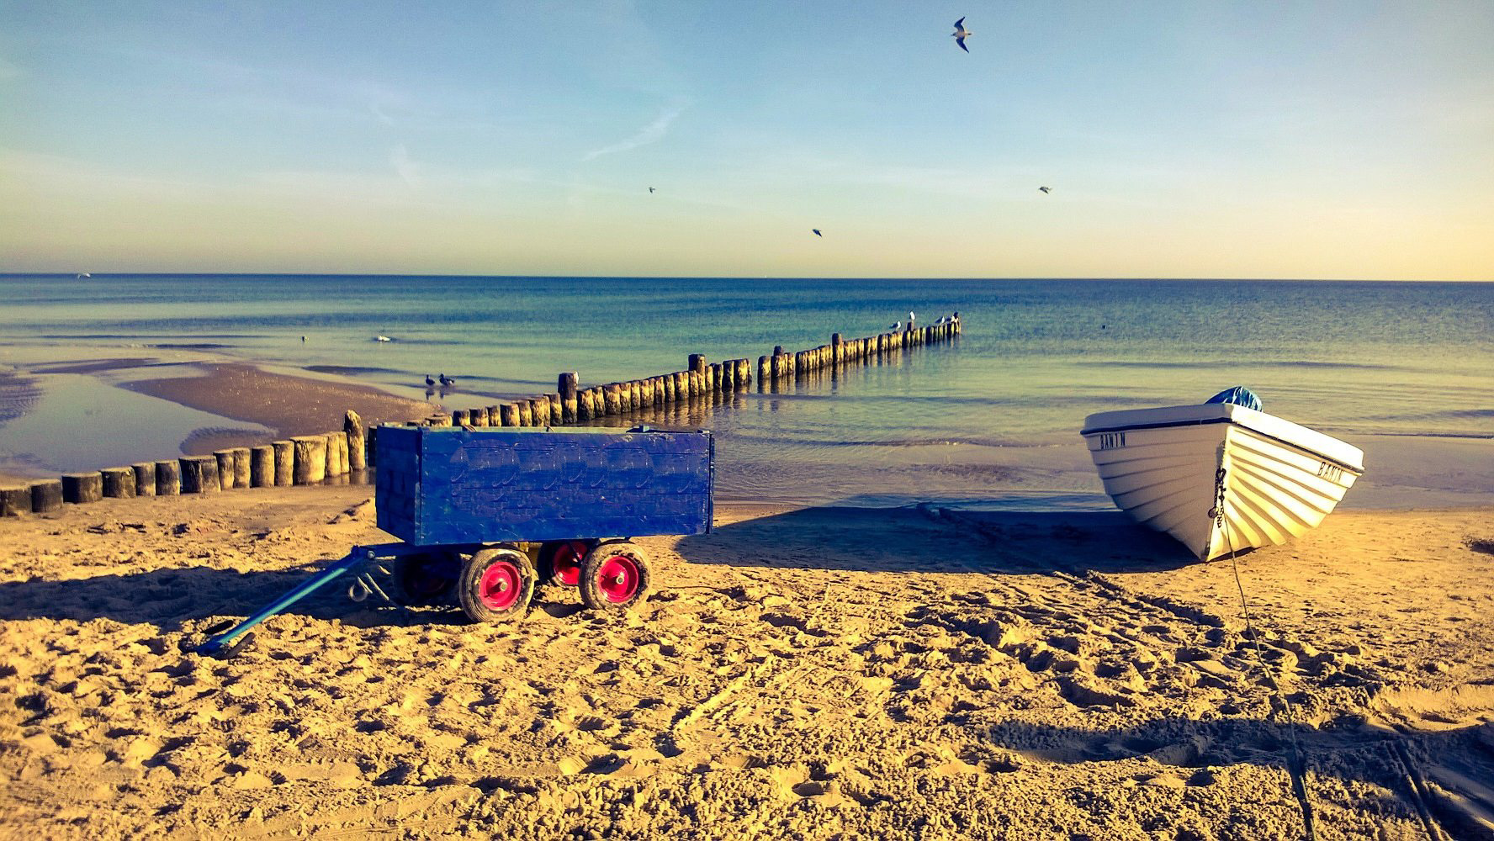
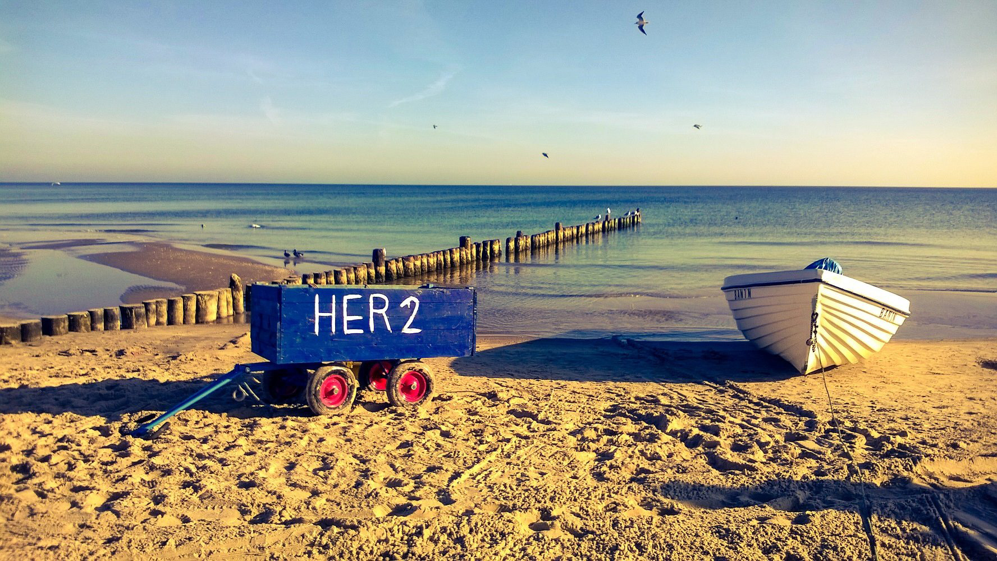
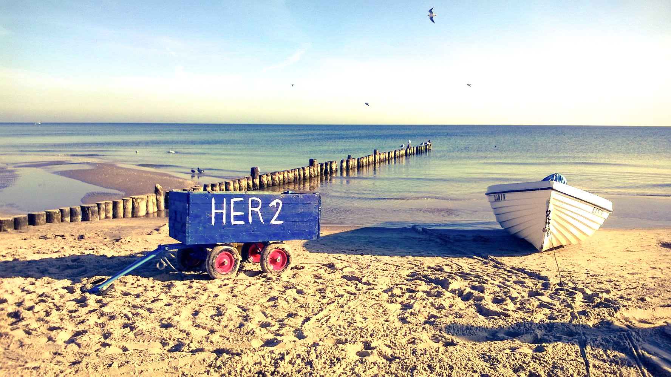
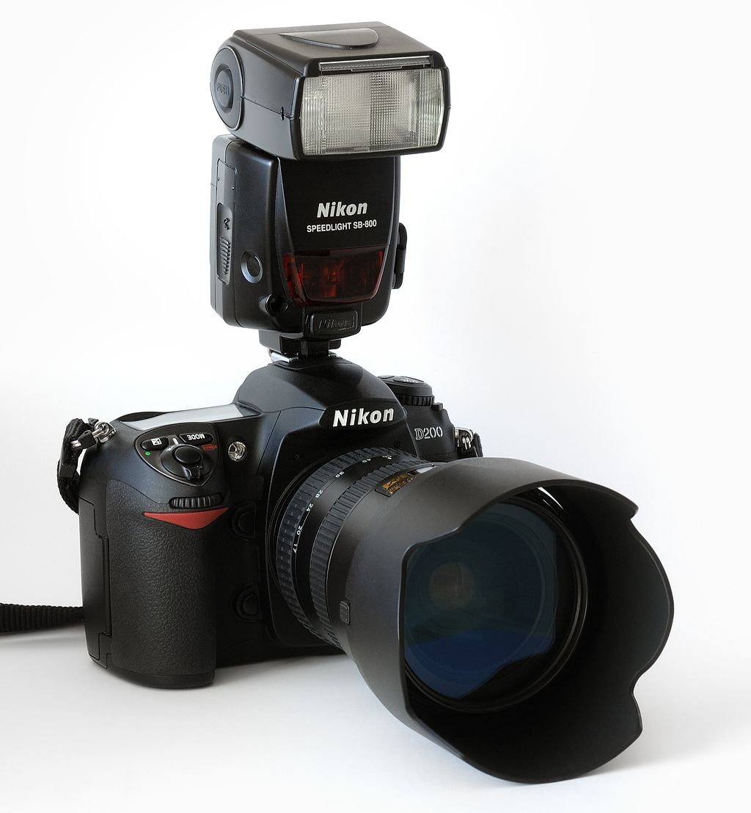
This is
image beautification,
not image analysis
Camera image source: André Karwath aka Aka, CC BY-SA 2.5, https://creativecommons.org/licenses/by-sa/2.5
https://en.wikipedia.org/wiki/Camera#/media/File:Nikon_D200_front_(aka).jpg

Slide 4



-
=
Image analysts use similar tools e.g. for feature extraction, and you are going to learn how they work.

Slide 5

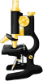

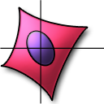

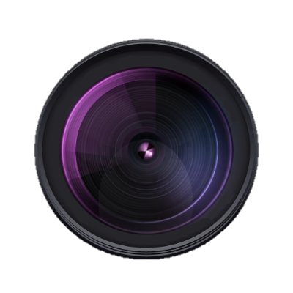



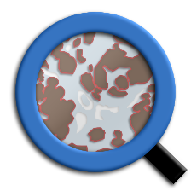
Open-Source software
Proprietary/Commercial/Licensed software
And there are many others
5

Slide 6
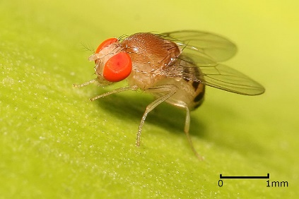
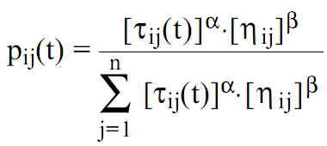
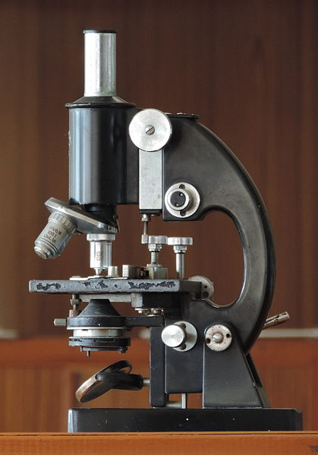
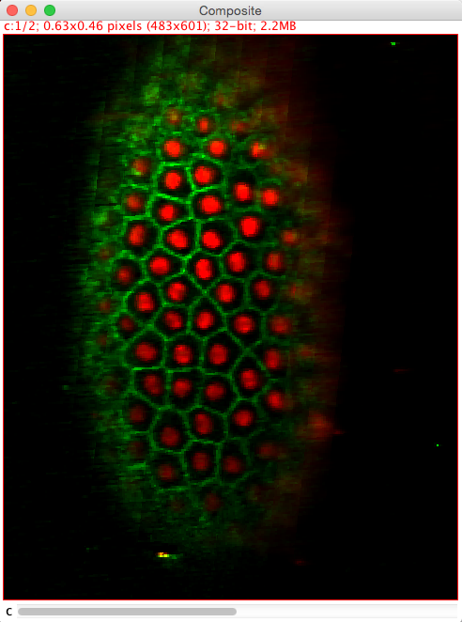
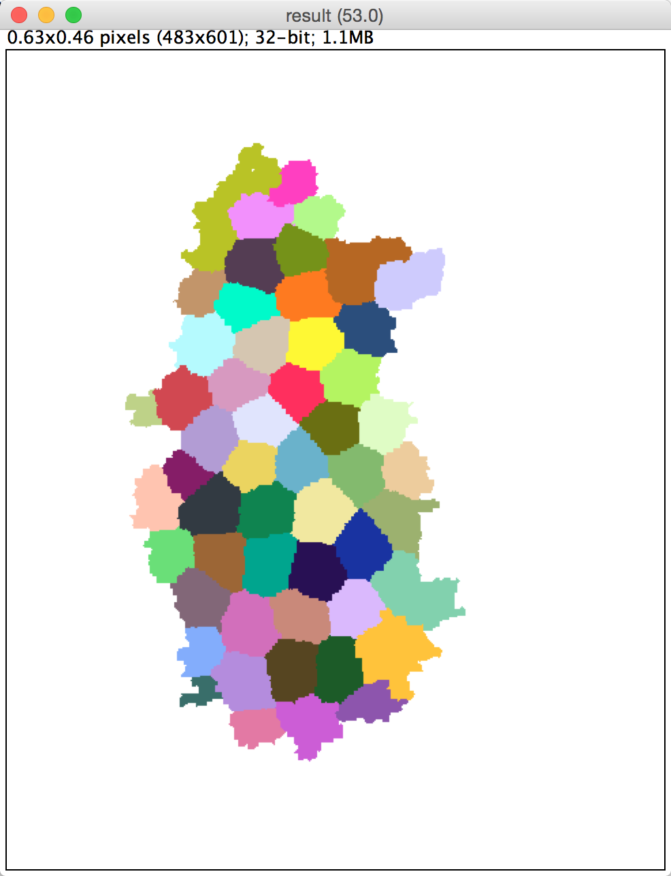
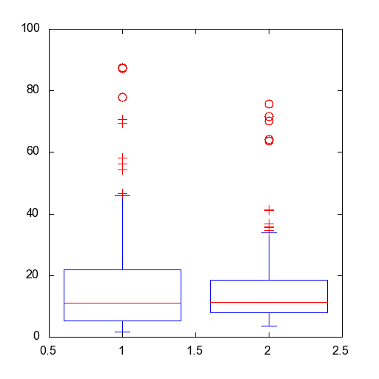
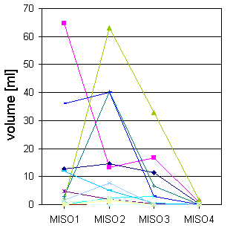
Observation
Modeling
IMAGE ANALYSIS IS A PART OF THE EXPERIMENT !
Image sources: Akanksha Jain, Tomancak lab, MPI CBG (SPIM image)
https://commons.wikimedia.org/wiki/User:Acagastya (Miroscope, public domain)
Muhammad Mahdi Karim (Drosophila, GFDL 1.2)
Box plot (Volume)
Volume in ml
Ant based delineation
Delineation from exp. observers
Image analysis
Bio-statistics
Imaging
Image processing

Slide 7
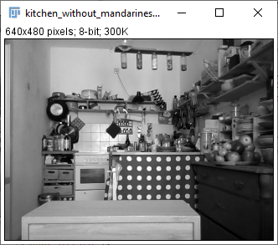
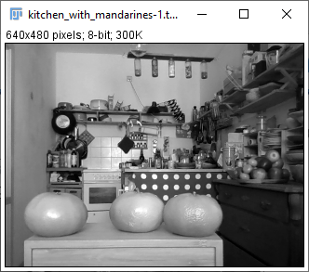
Bio-image analysis is supposed to be quantitative
The left image contains less mandarines than the image on the right.
The right image contains several mandarines.
Mandarine count
Left: 0
Right: 3

Slide 8
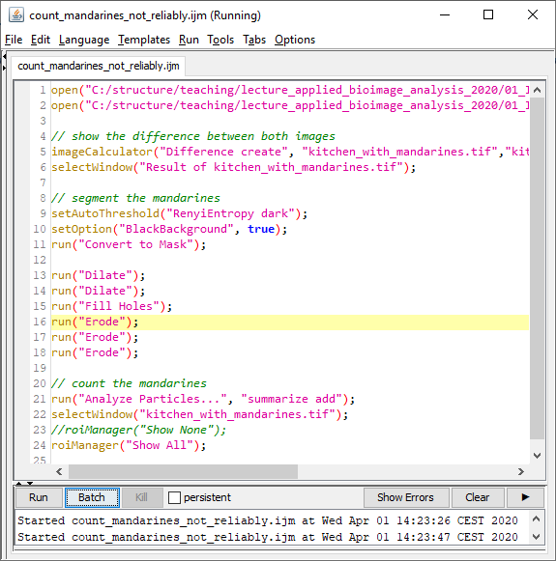
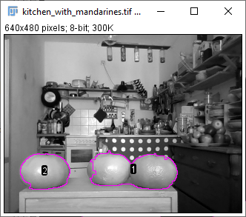
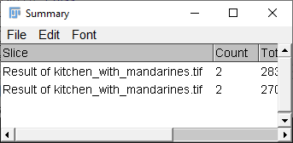
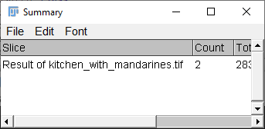
Bio-image analysis is supposed to be reliable

Slide 9
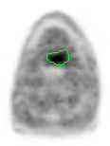
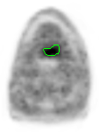
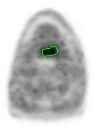
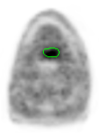
Bio-image analysis is supposed to be objective
Three experts outlining a tumor on Positron Emission Tomography data
One computer executing the same task
Observer 1:
17.3 ml
Observer 2:
7.5 ml
Observer 3:
9.9 ml
Automatic segmentation:
8.2 ml
Data source: N. Abolmaali, R. Haase, Oncoray, TU Dresden

Slide 10
https://forum.image.sc/t/quantifying-fluorescence-intensity-of-confocal-microscope-images/99960/2?u=daniel_waiger

Slide 11
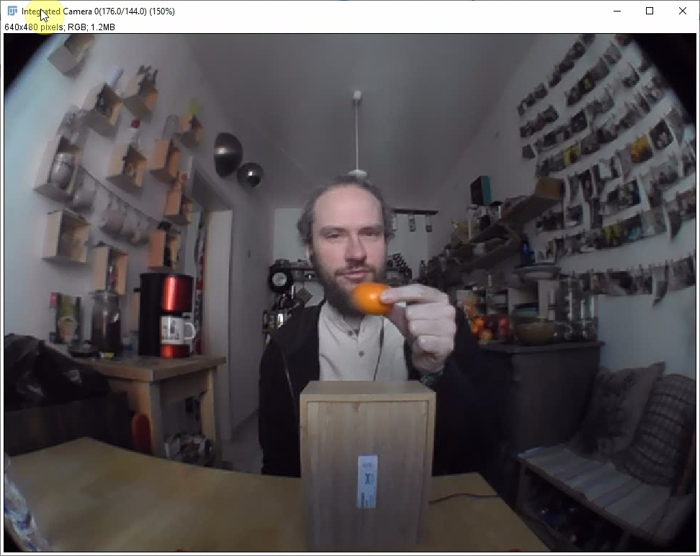
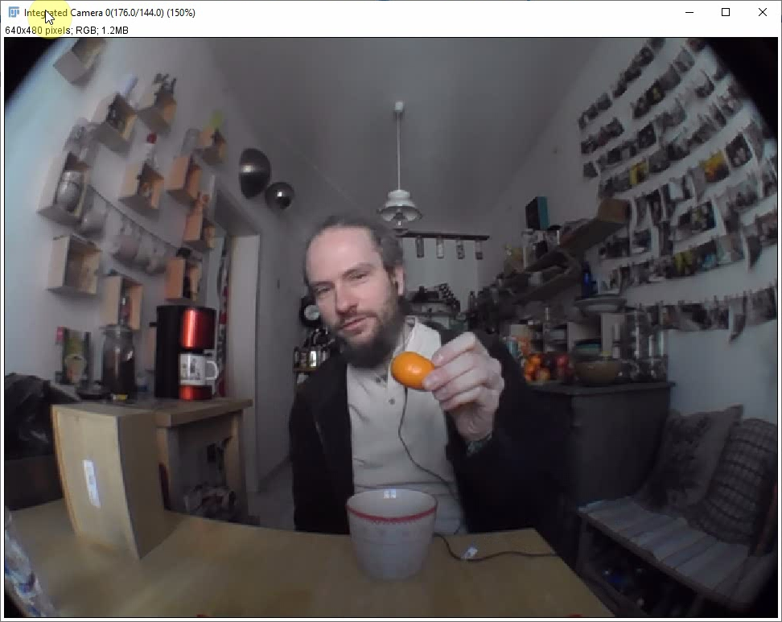
Bio-image analysis is supposed to be reproducible
Experiments must be documented so that others can repeat them.

Slide 12
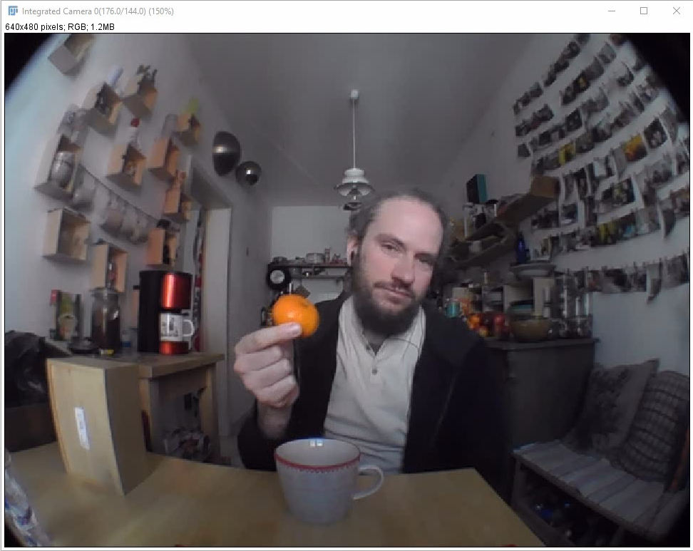
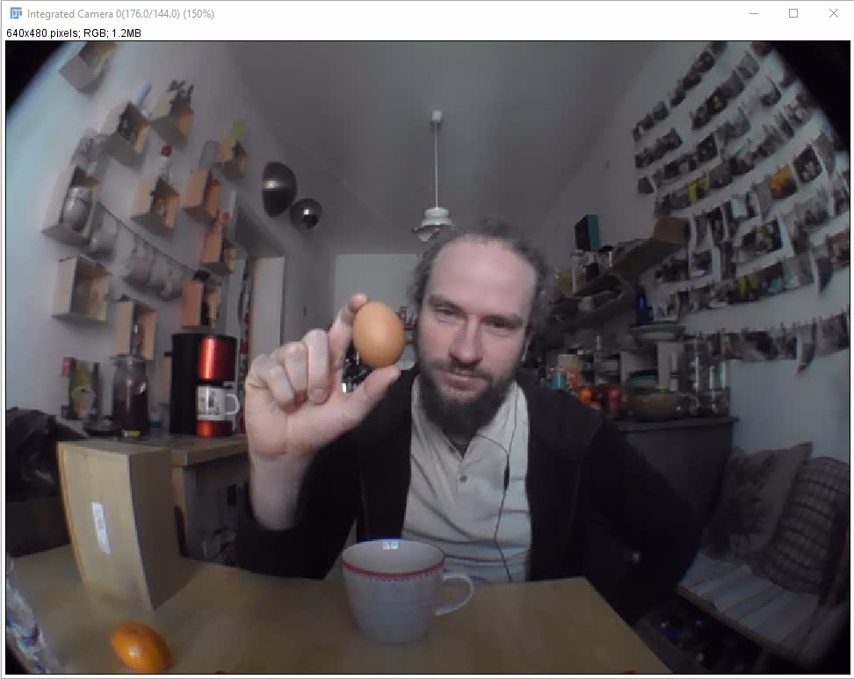
Bio-image analysis is supposed to be repeatable
The experiment must be designed so that one can repeat it with the same sample.

Slide 13
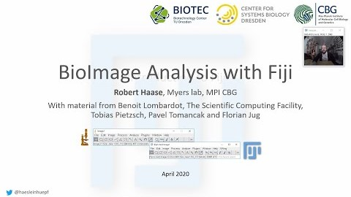
https://www.youtube.com/watch?v=e-2DbkUwKk4&list=PL5ESQNfM5lc7SAMstEu082ivW4BDMvd0U&index=1
Notes:
Start at: 12:08 End: 14:26

Slide 14
Bio-image analysis is supposed to be
Quantitative
We derive numbers from images which describe physical properties of the observed sample.
Objective
The derived measurement does not depend on who did the measurement. The measurement is free of interpretation.
Reliable
We are confident that the measurement is describing what it is supposed to describe.
Reproducible
Somebody else can do the experiment under different conditions and gets similar measurements. For this, documentation is decisive!
Repeatable
We can do the same experiment twice under the same conditions and get a similar measurements.

Slide 15
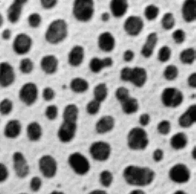

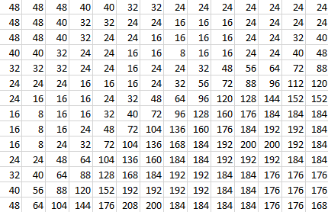

Images and pixels
An image is just a matrix of numbers
Pixel: “picture element”
The edges between pixels are an artefact. In reality, they don’t exist!
0
255

Slide 16
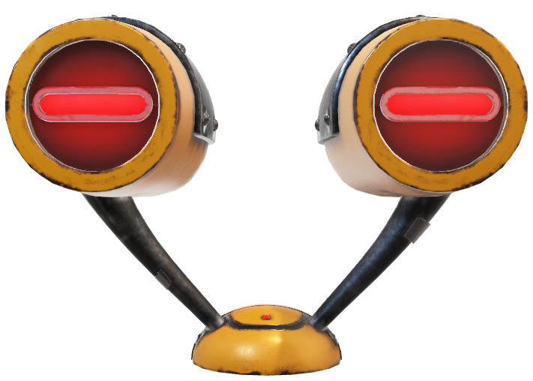
Images and pixels
Quantifying fluorescence is not as trivial as you think!

Slide 17
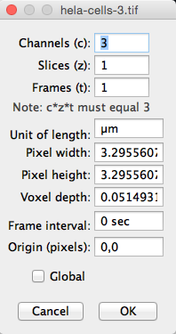

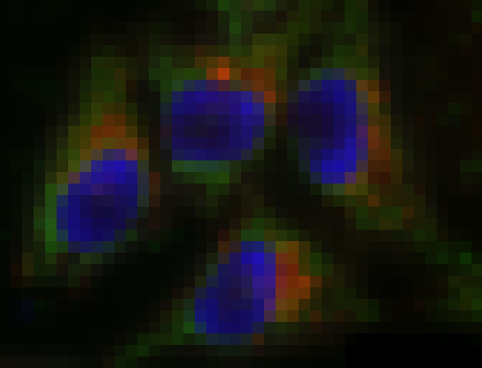

Pixel size versus resolution
Pixel size is a digital property of an image.
You configure it during the imaging session at the microscope.
Pixel size: 3.3 µm
Pixel size: 0.8 µm
Pixel size: 0.05 µm
We are not talking about resolution!
The “canvas” area is the same in all three cases.

Slide 18
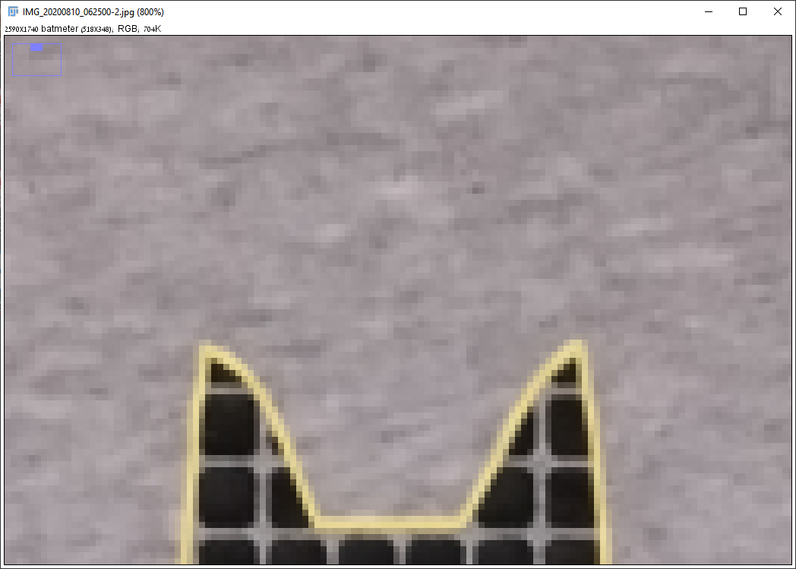
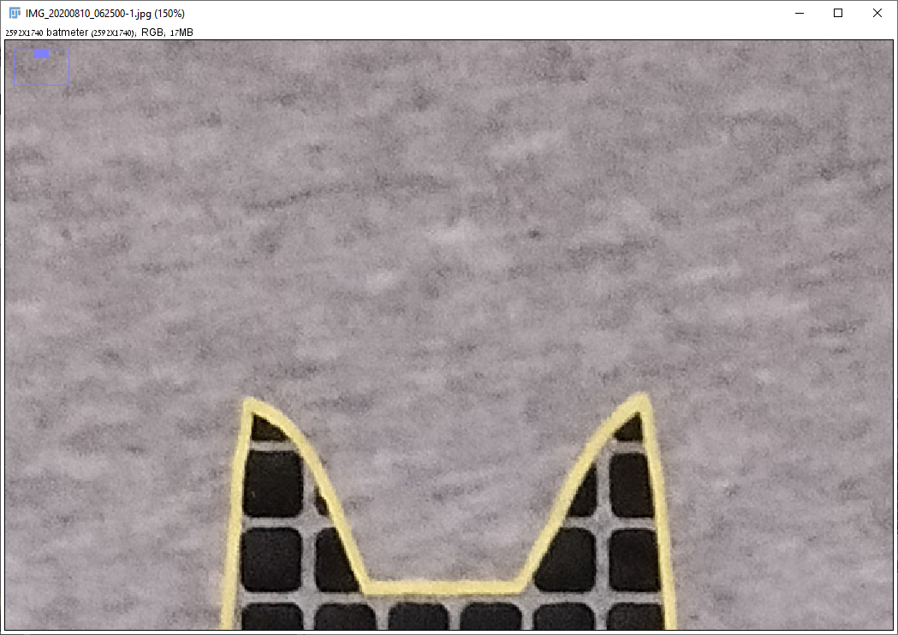
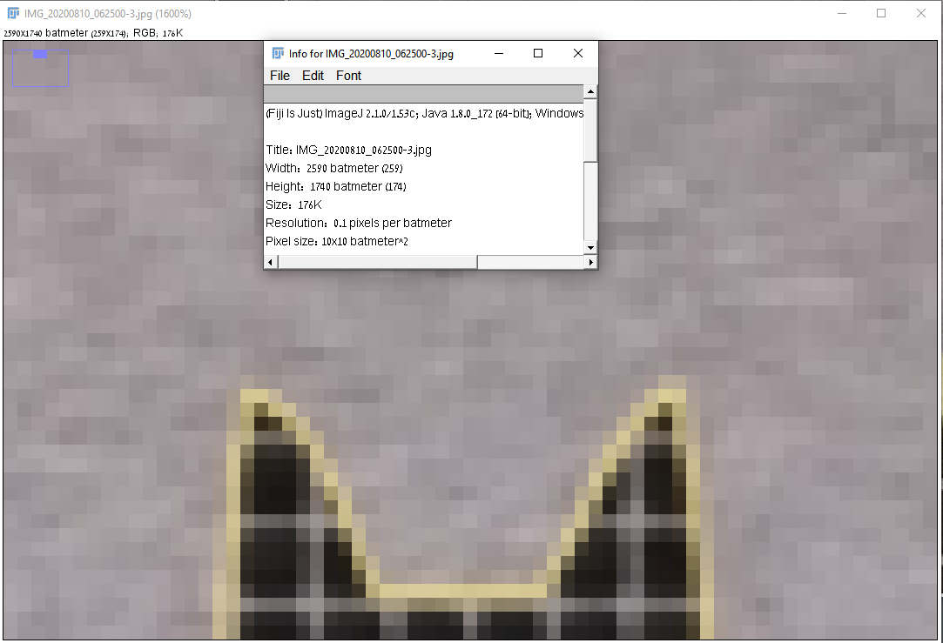
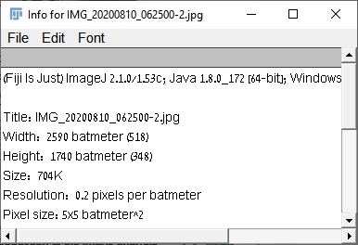
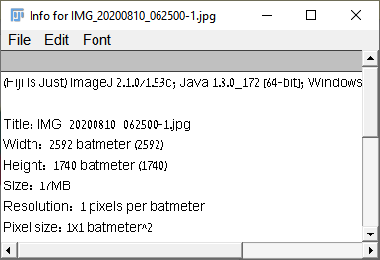
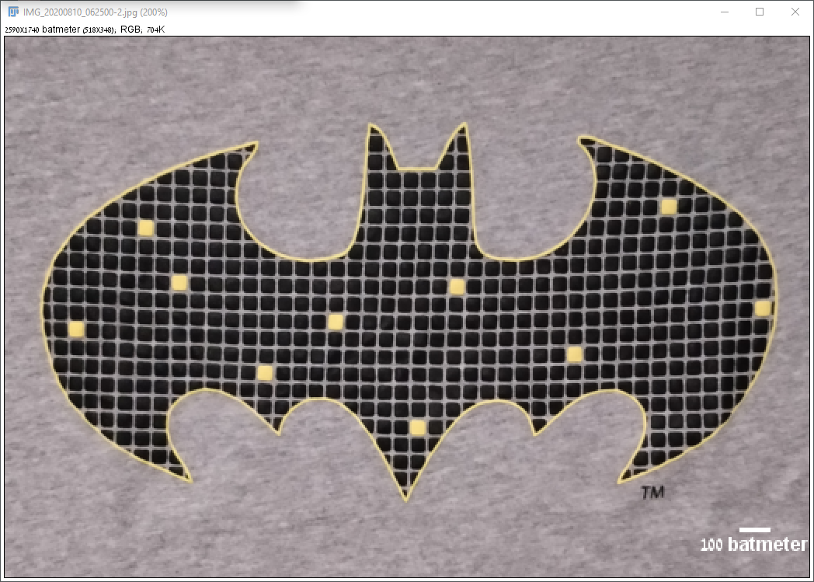
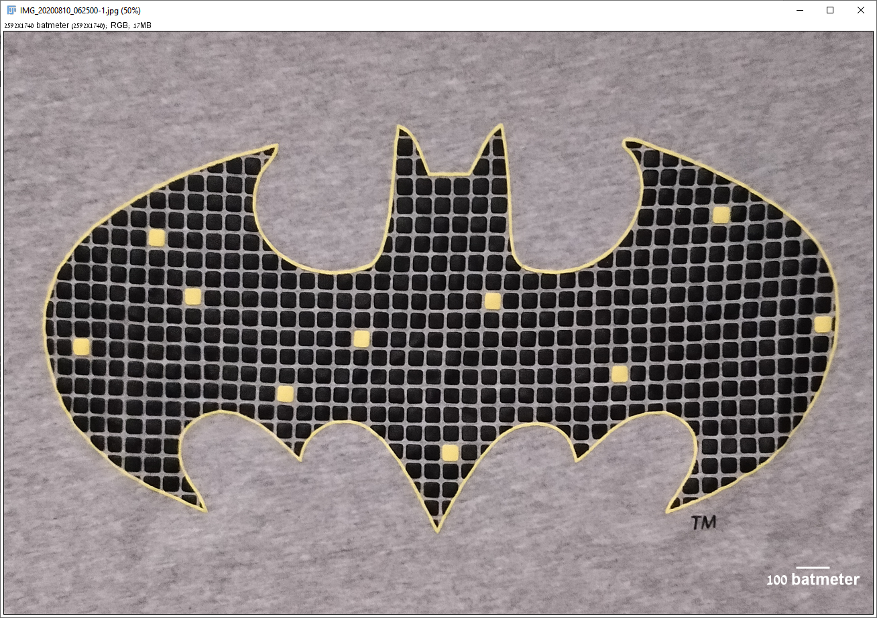
Pixel size versus resolution
Pixel size is a digital property of an image.
You configure it during the imaging session at the microscope.

Slide 19
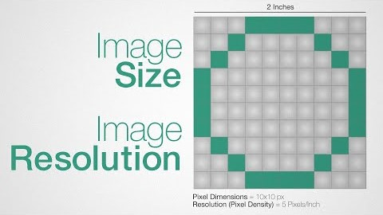
Pixel size versus resolution
Notice the increase in px size
https://www.youtube.com/watch?v=jp2Q2g0A5wc

Slide 20
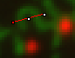
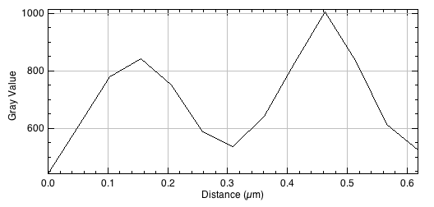

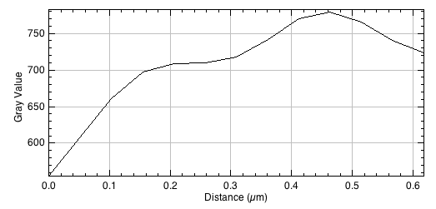
Pixel size versus resolution
Resolution is a property of your imaging system.
The measure of how close objects can be in an image while still being differentiable, is called spatial resolution – and it depends on our question!

Slide 21
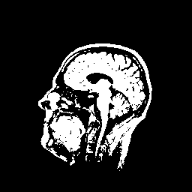
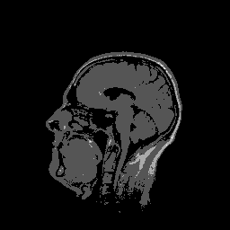









Bit-depth
A bit is the smallest memory unit in computers.
The bit-depth n enumerates how many different intensity values are present in an image:
2^{n} grey values
In microscopy, images are usually stored as 8, 12 or 16-bit images.
1
2
3
4
5
6
7
8
1
2
16

Slide 22
Bit-depth: Pitfalls
When working with 8-bit images, 256 different gray values can be saved.
That’s usually the numbers 0-255.
Depending on software:
100 – 200 = 0
100 – 200 = 155
100 + 200 = 255
100 + 200 = 45
Solution: When doing math with pixels, avoid bit-depth 8!

Slide 23




Lookup tables
The lookup table decides how the image is displayed on screen.
Applying a different lookup table doesn’t change the image. All pixel values stay the same, they just appear differently
Pixel value
Display color
Pixel value
Display color
Pixel value
Display color
0
1
2
…
255
0
1
2
…
255
0
1
2
…
255

Slide 24




Lookup tables
Choose visualization of your color tables wisely!
Think of people with red/green blindness!
Red/green blind people see it like this
Default view
Any of you doesn't see the difference?
Replace red with magenta!

Slide 25



Lookup tables
Lookup tables are a free choice.
They may (or may not) express which wavelengths has been imaged before.
Hint: Try not to do arts.

Slide 26



Remember them?

Slide 27
















Fiji is just ImageJ – Included with ninja skills.
Trackmate
Core ImageJ
FigureJ
The list is long, but there is a tool for everyone!
StarDist
Ridge detection
TrakEM

Slide 28


Fiji – a true story of love and hate
Included plugins for many purposes
Flexibility ☺
Applicability ☺
User experience ☹
Maintenance ☹
Optional plugins: http://imagej.net/List_of_update_sites
Extensibility ☺
https://twitter.com/haesleinhuepf/status/1288372583495327744

Slide 29

Fiji user experience
The menus are confusing and not very well organized
Use the search field!
It shows you where the plugin is located
You can run it from here (press enter)
Allows you searching
for plugins / menus
Operations (ops)
ImageJ wiki
Forum

Slide 30






Fiji example workflow
Popular basic analysis fluorescence pipeline: thresholding + particle analysis
From images to raw data for statistics and *omics post-processing
Always Duplicate your image(s) – *Never apply threshold!

Slide 31





Fijis user interface
There are more tools hidden in the toolbar than expected…
Use the right click to discover them!

Slide 32


Distance measurements
For simple distance measurements, use the line tool and observe the status bar of FIJI

Slide 33


Distance measurements
Use the M key to store a length-measurement to the results table.

Slide 34



Fijis user interface
Zoom factor
Image type
Image size in physical units (and in pixels)
Current color channel
Current slice-position in space
Current position in time (frame number)

Slide 35



Correct pixel size
Set pixel size by using Image > Properties
Here you can enter “um” instead of “µm”. It will be interpreted as micrometer
Analyze > Set scale is a workaround; it’s not precise!

Slide 36
Fiji basics – Measurement tools.
https://youtu.be/Akedfyp5AxY
Notes:
Start: 06:50 End: 10:50

Slide 37




Visualisation: brightness / contrast
After opening an image, adjust Brightness & Contrast in order to *see* it properly
Use the menu Image > Adjust > Brightness & Contrast (CTRL+SHIFT+C)

Slide 38



Visualisation: brightness / contrast
After opening an image, adjust Brightness & Contrast in order to *see* it properly
Use the menu Image > Adjust > Brightness & Contrast (CTRL+SHIFT+C)

Slide 39



Visualisation: brightness / contrast
After opening an image, adjust Brightness & Contrast in order to *see* it properly
Use the menu Image > Adjust > Brightness & Contrast (CTRL+SHIFT+C)

Slide 40



Visualisation: brightness / contrast
Define the grey value range to visualize
Also known as “windowing”
Menu Image > Adjust > Brightess/Contrast or Ctrl+Shift+C
Try to “window” the object you would like to see best.
This may be the “hill” in the histogram

Slide 41




Channel selection
In multi-channel images, brightness and contrast must be configured for channels individually

Slide 42





Channel selection
Intensity measurements depend on the selected channel!

Slide 43

Lookup tables
Choose visualization of your color tables wisely!
Think of people with red/green blindness!

Slide 44







Regions of interest (ROI)
draw a rectangle
using the rectangle tool
draw a circle
using the circle tool
add objects to the ROI
by holding SHIFT
unite objects to the ROI
by holding SHIFT
subtract objects to the
ROI by holding ALT
move the ROI
by clicking inside and move the mouse
delete the ROI
by clicking outside
Recover the last ROI by using menu Edit > Selection > Restore Selection (SHIFT+CTRL+E)

Slide 45


Fiji basics – Exercise 1.
Take 10 min. to find out how many blobs are in the image.

Slide 46
Fiji example workflow
Popular basic analysis pipeline: thresholding + particle analysis
From images to raw data for statistics and *omics post-processing
Blobs → Threshold → Set Measurements → Analyze Particles → !Results!

Slide 47

Fiji example workflow
From a multichannel z-stack (3D) to 3 separate 2D images.
Notice the Channel and Z sliders

Slide 48



Fiji example workflow
Step 01: Channel splitting
Image > Color > Split Channels
Notice the Z slider
Channel 1 = DAPI (BLUE)
Channel 3 = FIBRILLARIN (RED)
Channel 2 = BRIGHTFIELD

Slide 49
Fiji example workflow
OPTIONAL
Step 02: Applying LUTs – For ease of viewing our organelles (Cyan Hot – Blue) / (Red Hot – Red)
Image > Lookup Tables > LUT of choice
Brightfield image is not useful in this case
Notice that we haven’t manipulated our data, we just view it in with arbitrary color(s).
Channel 1 = DAPI (BLUE)
Channel 3 = FIBRILLARIN (RED)

Slide 50


Fiji example workflow
Steps 03-04: Counting particles
Analyze > Set Measurements> Tick boxes.
Analyze > Analyze Particles> Choose Min-Max particle size (in um^2 or pixel^2)> Tick boxes.

Slide 51




Fiji example workflow
OPTIONAL
Step 05: Merging Channels– For recombining our images into one new image (Cyan Hot – Blue) / (Red Hot – Red)
Image > Color> Merge Channels (remember which channel was which color).

Slide 52
Few messages from our sponsors:
Seeing is believing
Measuring is science!
Also:
In imaging (including image analysis), S**T IN = S**T OUT!

Slide 53



Image integrity and standards
Figure and Video Guidelines | Journal of Cell Biology | Rockefeller University Press (rupress.org)

Slide 54


Image integrity and standards
Image integrity and standards | Nature Portfolio

Slide 55



Image integrity and standards
Instructions for preparing an initial manuscript | Science | AAAS (sciencemag.org)

Slide 56






Macro programming - resources
Each image is a clickable link
Take your time here, Anna is a great teacher!
Good for weekends.
At least try exercise #1 – that’s the best and easiest way to start

Slide 57
Softwre Tutorials - resources
(46) Johanna M. Dela Cruz - YouTube
(46) haesleinhuepf - YouTube
NEUBIAS - YouTube

Slide 58


Microscopy for Dummies (zeiss.com)

Slide 59
Questions?
Keep in mind: It is an intro; we’re not expecting you to remember it all today.

Slide 60


Fiji & reproducible research: macros (Automation)
The macro recorder and the script editor allow scripting Fiji and thus, reproducible workflows.
Run workflows on hundreds or thousands of images!
Runs on the background

Slide 61



Macro recorder
Choose IJ1 Macro as the language for your script

Slide 62
Bio-image analysis is supposed to be reliable

Slide 63



Micro-Formats Extractor
https://github.com/image-analysis/micro-formats-extractor

Slide 64

Plugins: FigureJ – image panel creation
Schematic overview of an example workflow – from 2D nuclei to particle count within them (on a different channel).

Slide 65
Basic generalizing your macro

Slide 66
Plugins – Stardist, ilastik, clij2, how to install

Slide 67

Metadata is important
What microscope was he using?
Or in other words – this guy knows that in microscopy it’s shit in = shit out!

Slide 68
PLUGINS SHOWCASE

Slide 69




Plugins: StarDist 2D – Automatic nuclei segmentation - DAPI

Slide 70


Plugins: WEKA – same as ilastik (but only as pixel classification workflow)

Slide 71



Plugins: StarDist 2D – Automatic nuclei segmentation – H&E staining
Not perfect – can be adjusted for better results!

Slide 72




Software: Ilastik (also a Fiji plugin)

Slide 73

Software: Ilastik (also a Fiji plugin)

Slide 74

NEED HELP?

Slide 75
Let’s work on the practical – FIJI TRAINING

Slide 76

imaris
Co-localization of mutant protein on α-Tubulin filaments
Raw confocal data
3D rendering w/imaris
Blue/Red Dots – Oly protein
Green – α-Tubulin filaments

Slide 77

One last thing about protocols…
How mounting media can affect tissue thickness:
https://twitter.com/patrina_pellett/status/824692850285645824

Slide 78


Take it from the pros…(from previous slide)
1
2

